Slide 1
Scavenger Hunt

Slide 2
I come in pairs, I’m easy to lose, I go between your feet and your shoes.

Slide 3
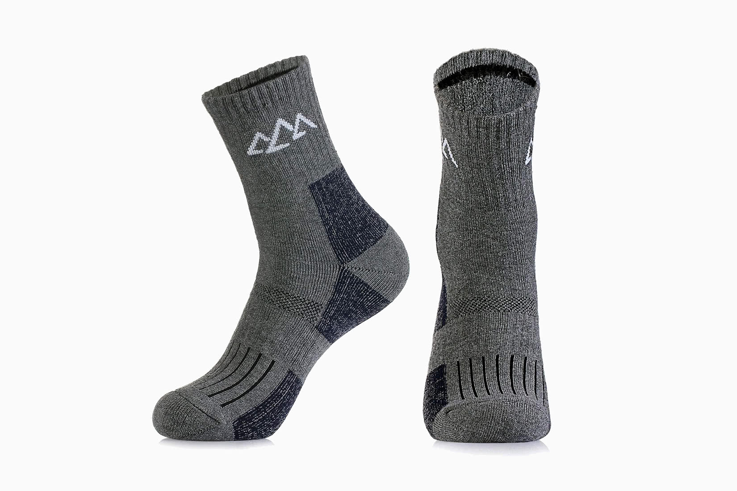

Slide 4
I am a household item
But I am not a clock
I’m something that beats paper
But I’m beaten by rock

Slide 5
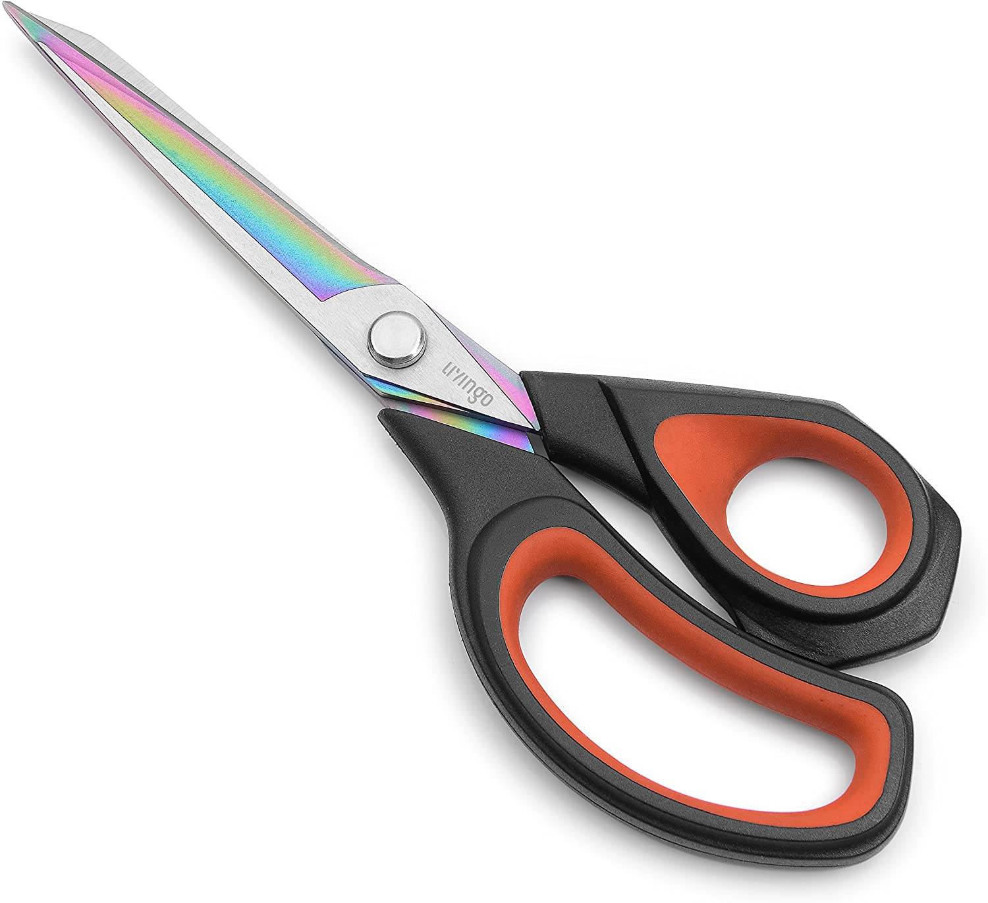

Slide 6
I have a neck but no head, yet can still wear a cap.

Slide 7
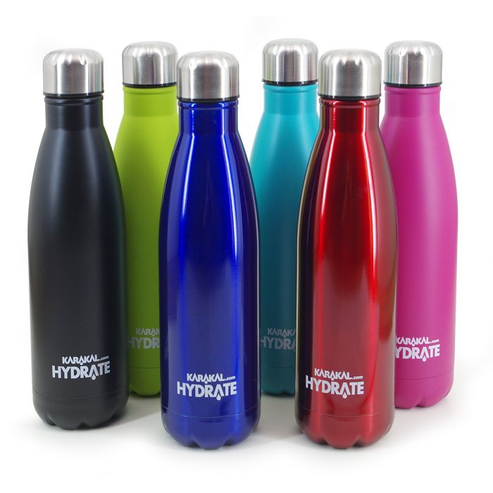

Slide 8
In a bowl or on a hook,
Keep me somewhere you will look.
On a shelf or in your pocket,
Have me near before you lock it.

Slide 9


Slide 10
Put your phone in me after dropping it in water. I also make a cheap and easy dinner, on nights you just don’t want to bother.

Slide 11


Slide 12
What demands an answer, but asks no questions?
What has a ring but no finger?

Slide 13
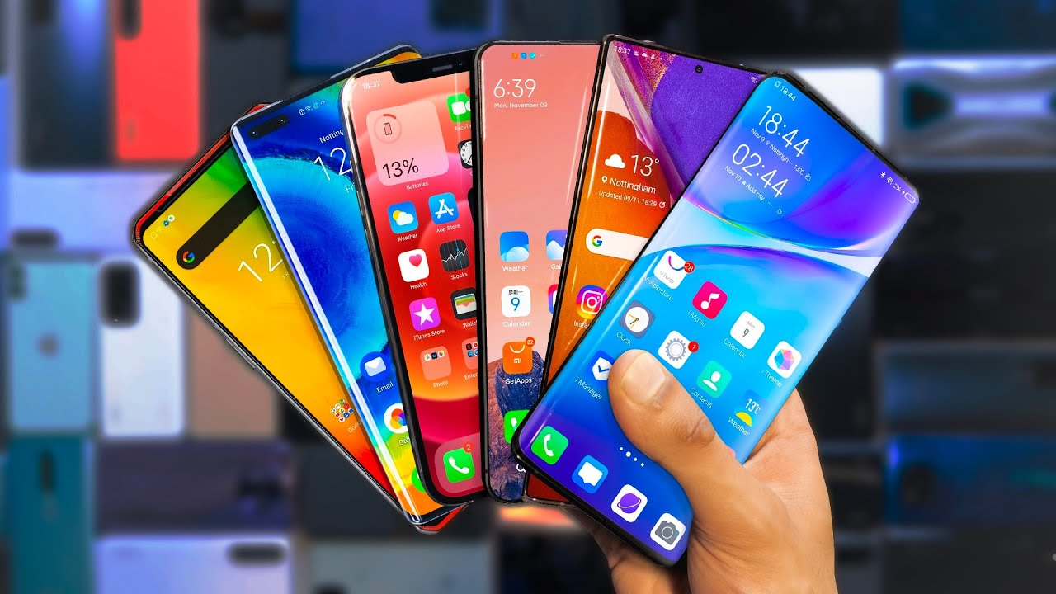

Slide 14
Give me a tap and I’ll give you some protection,
I come in handy when you're outside.

Slide 15


Slide 16
You can find me big and small, I hang around all day,
when I’m not needed, I’m out of sight, folded and put away.

Slide 17
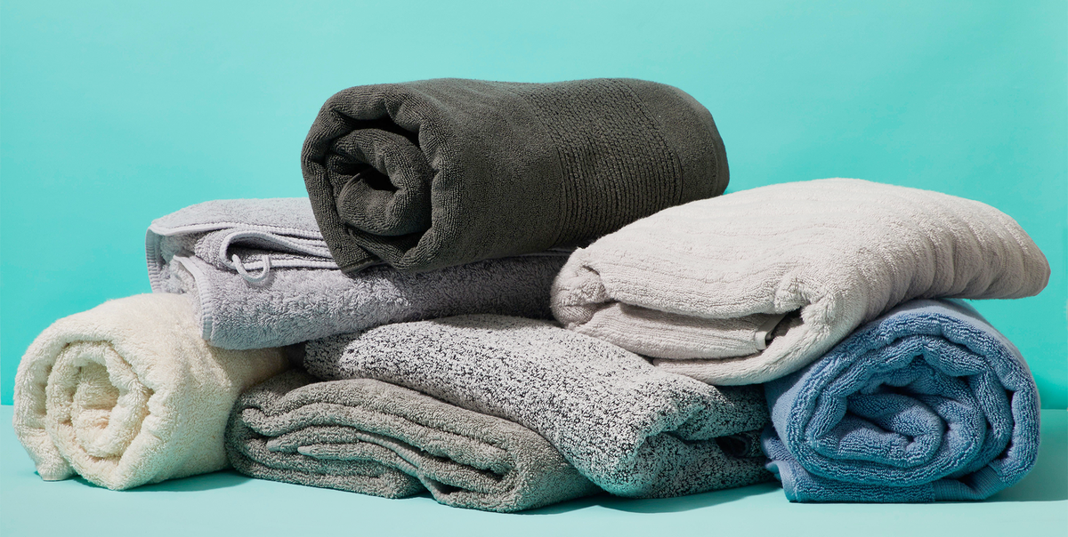

Slide 18
Look in my face and I am someone,
Look in my back I am no one.

Slide 19


Slide 20
​​When rain’s in the forecast and you don’t want to get wet, grabbing me before you leave the house is a safe bet.

Slide 21


Slide 22
I’m here to wake you up, but just hit snooze and I’ll shut up.

Slide 23
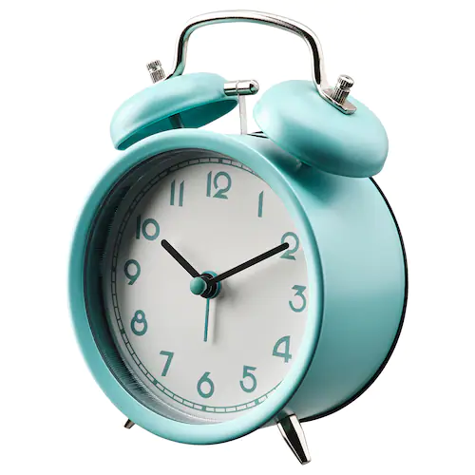

Slide 24
What has many teeth, but can’t bite?

Slide 25
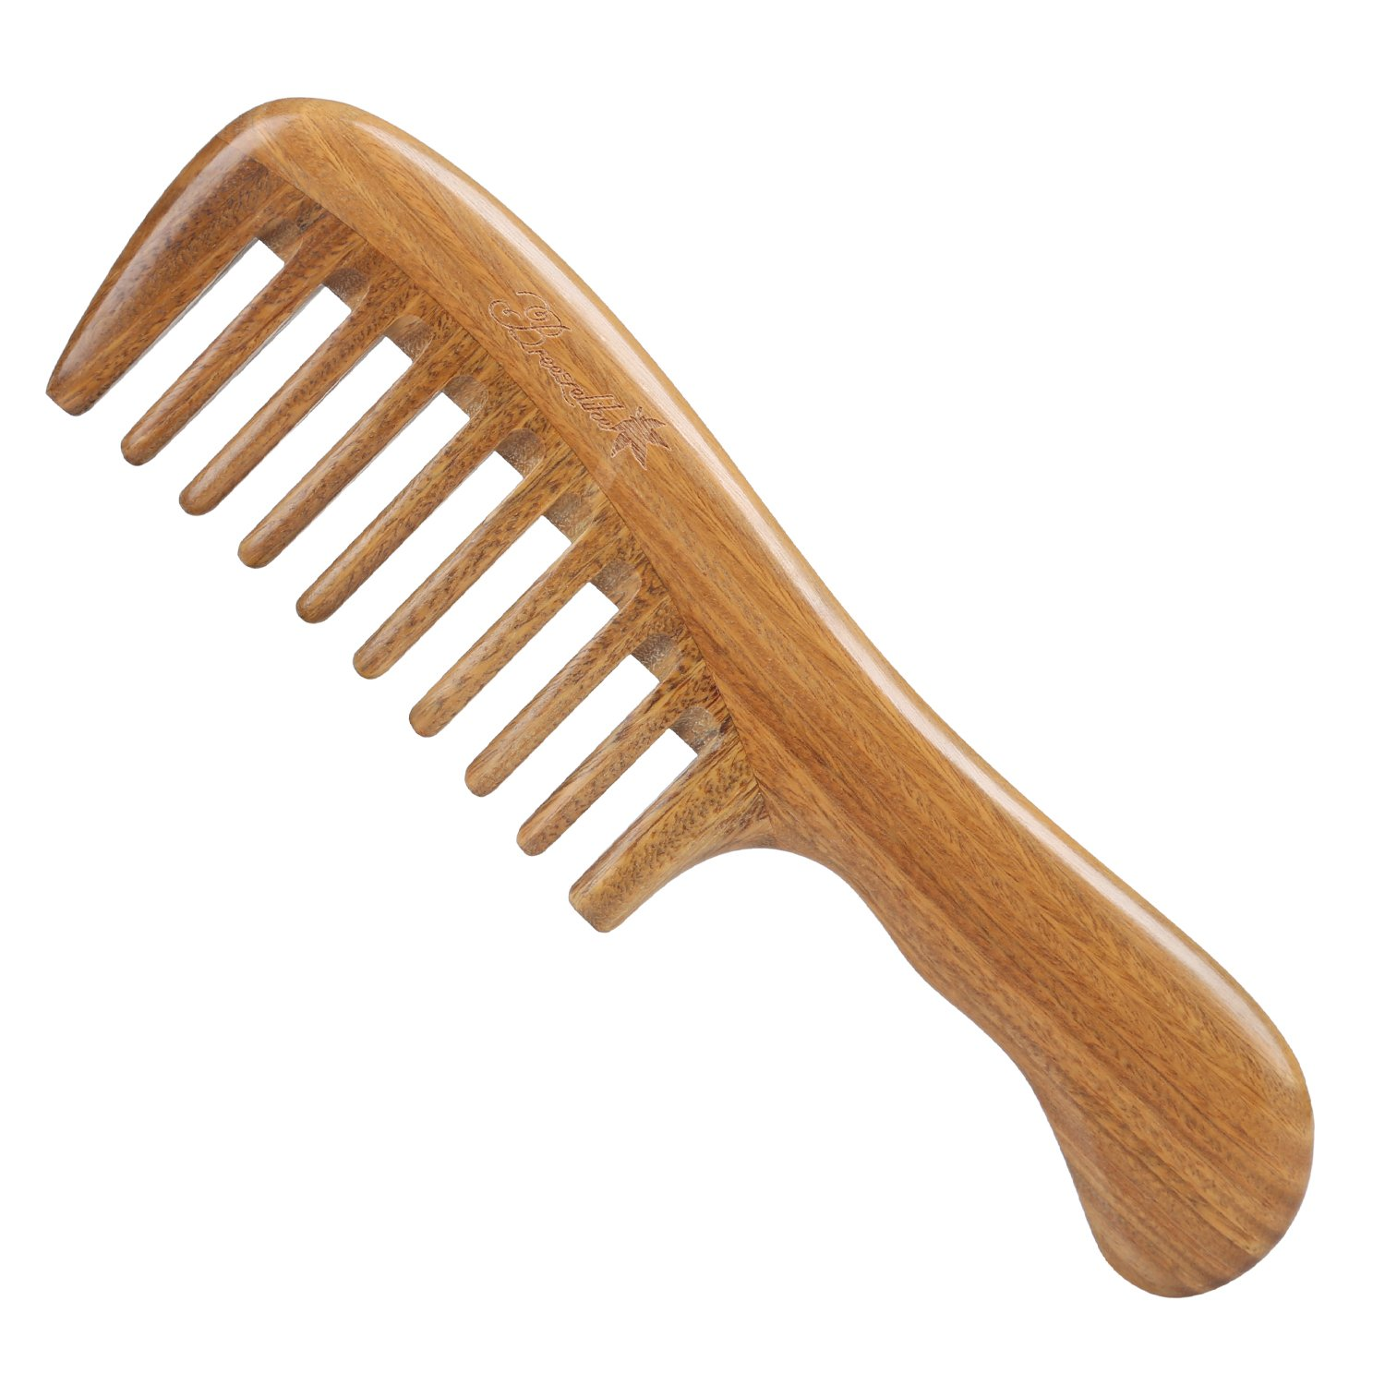

Slide 26
Thank you!

